Slide 1
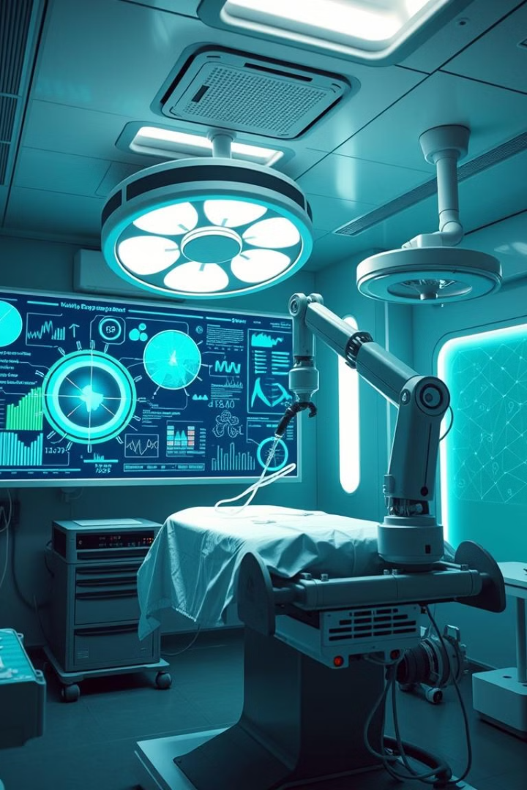

AI in Medical Imaging: Revolutionizing Healthcare
AI is transforming healthcare, particularly in medical imaging. AI-powered algorithms can analyze medical images to detect abnormalities, assist in diagnosis, and enhance treatment planning.
Guided By - Dr. P Chandra Shaker Reddy Professor of CSE SR University, Warangal, TS, India
by Muthuri Laxmigovini
2203A52041
Batch - 31

Slide 2

Introduction to AI in Healthcare
1
Machine Learning for Healthcare
2
Improving Diagnostic Accuracy
AI algorithms, specifically machine learning models, can analyze vast amounts of medical data to learn patterns and make predictions.
AI can help doctors detect subtle abnormalities that might be missed by the human eye, leading to earlier and more accurate diagnoses.
3
Personalized Medicine
4
Streamlining Workflows
AI can analyze individual patient data to create personalized treatment plans tailored to their specific needs and genetic makeup.
AI can automate repetitive tasks like image analysis, freeing up clinicians' time for more complex and patient-centric activities.

Slide 3
The Role of AI in Medical Imaging
Image Analysis
Disease Detection
Treatment Planning
AI algorithms can analyze medical images to identify abnormalities, measure sizes, and classify different tissue types.
AI can help detect diseases like cancer, cardiovascular disease, and neurological disorders at an early stage.
AI can assist in planning surgery, radiotherapy, and other treatments by providing insights into tumor location, size, and surrounding tissues.

Slide 4
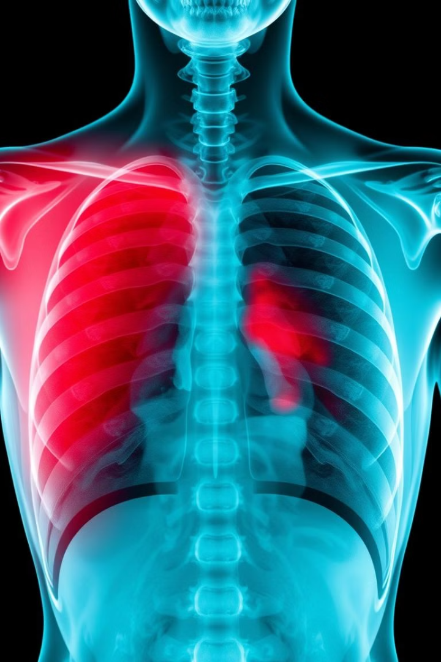



Applications of AI in X-Ray Analysis
Pneumonia Detection
AI models can identify patterns in X-ray images that indicate the presence of pneumonia, improving diagnosis and treatment.
Fracture Detection
AI algorithms can accurately detect bone fractures, reducing the need for manual review and enabling faster treatment.
Bone Density Analysis
AI can analyze bone density in X-ray images, helping diagnose conditions like osteoporosis and assess fracture risk.

Slide 5

Detecting Abnormalities in MRI Scans
Brain Tumors
AI can detect tumors in MRI scans, assisting in diagnosis and treatment planning.
Stroke
AI algorithms can identify signs of stroke in MRI scans, enabling faster intervention and improving outcomes.
Multiple Sclerosis
AI can help diagnose multiple sclerosis by identifying lesions in the brain and spinal cord in MRI scans.

Slide 6
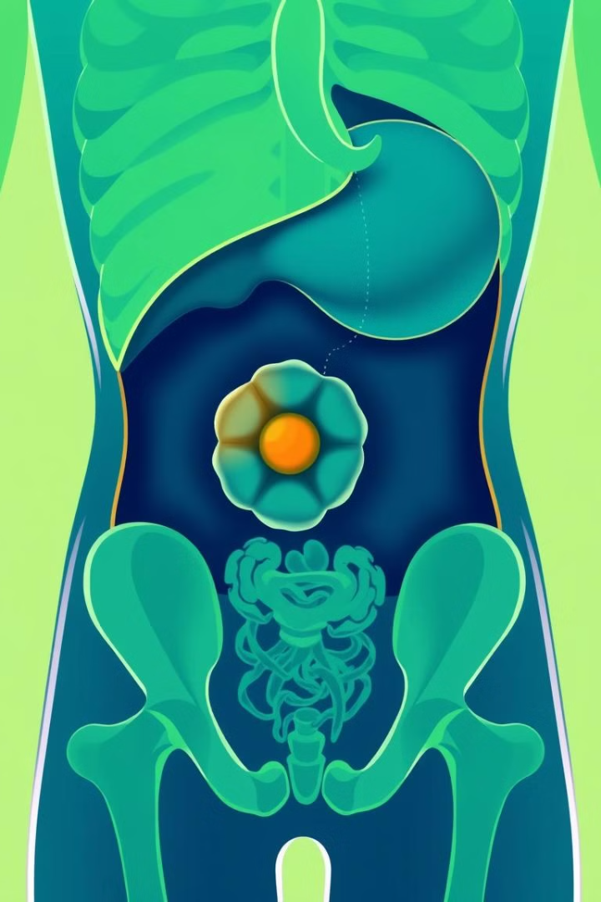



Leveraging AI for CT Scan Interpretation
Lung Cancer Detection
AI can detect lung cancer in CT scans, helping diagnose the disease at an early stage when treatment is most effective.
Cardiovascular Disease Assessment
AI can analyze CT scans of the heart to assess risk factors for cardiovascular disease and monitor disease progression.
Bone Fracture Analysis
AI can help identify bone fractures in CT scans, providing accurate information for treatment planning and recovery.

Slide 7

Improving Diagnostic Accuracy and Efficiency
1
Reduced Errors
AI algorithms can help reduce human error in image interpretation, leading to more accurate diagnoses and treatment plans.
2
Faster Diagnosis
AI can analyze images much faster than humans, allowing for faster diagnosis and treatment initiation.
3
Improved Patient Outcomes
Earlier and more accurate diagnoses can lead to improved patient outcomes and better chances of recovery.

Slide 8

Challenges and Limitations of AI in Medical Imaging
Data Bias
Explainability
Regulatory Challenges
AI models can be biased if trained on datasets that do not represent the diversity of the population.
Understanding how AI models make decisions is crucial for trust and accountability in medical settings.
Ensuring the safety and efficacy of AI in medical imaging requires robust regulatory frameworks and clinical trials.

Slide 9

Ethical Considerations and Responsible AI Implementation
1
Patient Privacy
2
Transparency
3
Human Oversight
Protecting patient privacy is paramount when using AI in healthcare, and robust data security measures must be implemented.
Transparency in AI algorithms is essential for understanding how decisions are made and ensuring accountability.
AI should be used as a tool to augment human expertise, not replace it entirely.

Slide 10
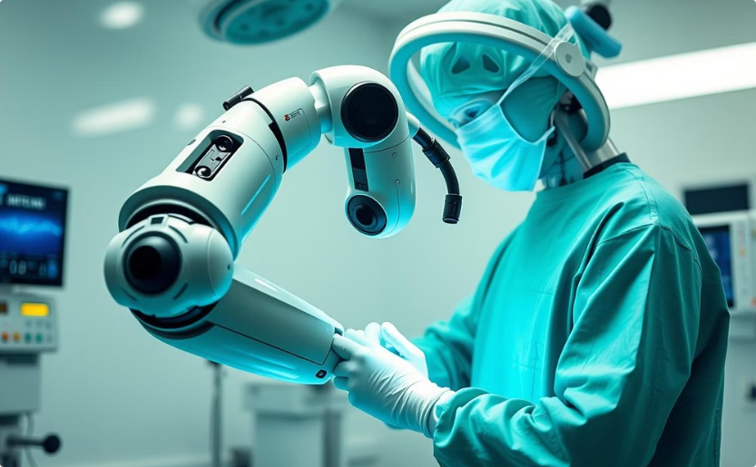

The Future of AI in Medical Imaging: Trends and Opportunities
Robotic Surgery
Virtual Reality Therapy
AI-powered robotic surgery can improve precision, minimize complications, and enhance patient recovery.
AI-powered virtual reality therapy can be used for pain management, rehabilitation, and mental health treatment.

Slide 11


